Slide 1
Cognitive Status Use Case Scenario (example)
Pacio project

Slide 2
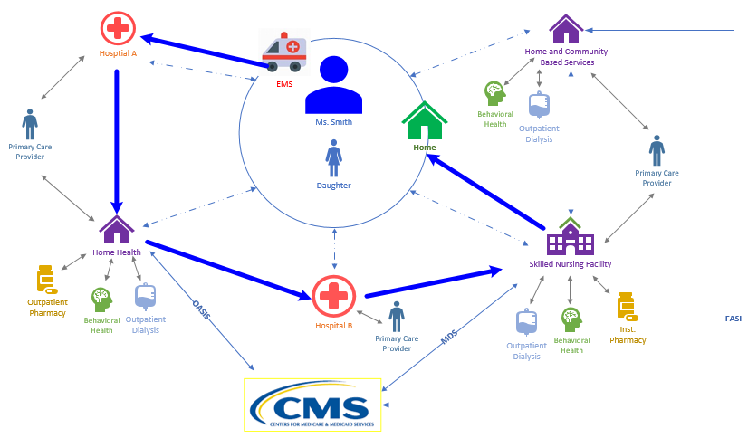

The Patient Story: Focus on Transfer from the Skilled Nursing Facility to Home Health
Transfer
Summary
Transfer
Summary
Transfer
Summary
Transfer
Summary

Slide 3
Patient
Ms. Smith and her perspective

Slide 4
Social History
Ms. Smith is a 68 year old white female widow
Retired 3 years ago
Moved from Maryland to Texas.
Prior to her retirement, she worked as a receptionist in a hotel lobby
Depends on her social security check as her primary source on income
Patient lives alone
Patient is Alert and Oriented x 3
Remains independent in her Activities of Daily Living (ADLs)
Functionally independent with a cane
Drives her own car to get to medical appointments
Increasingly reliant on friends to drive her, due to intermittent dyspnea and blurry vision in her right eye
She has two children, a son and a daughter, who still reside in Maryland
Daughter works as an accountant, is married and has children
Son lives alone and works as a lawyer
Communication is poor between family members and Ms. Smith rarely discusses her healthcare with them

Slide 5
Medical History
PAST MEDICAL HISTORY
Patient leads a sedentary lifestyle and follows a poor diet with little exercise, which is a result of low health literacy, poor social support and multiple comorbidities. Patient has also started to experience frequent falls due to the osteoarthritis of the right hip. Patient was diagnosed with the following while she was in Maryland:
• Hypertension • Depression
• Hyperlipidemia • Cataracts
• Stage 3 chronic kidney disease • Osteoarthritis
• Ischemic heart disease • Type 2 diabetes

Slide 6
Current Medications
Patient has a complex medication list, which contributes to poor adherence.
• Lisinopril 40mg twice a day • Glargine 24 units SQ nightly
• Atorvastatin 40mg nightly • Insulin 3 units with each meal
• Calcium 500mg daily • Sertraline 25mg nightly
• Vitamin D 800IU daily • Tylenol 650mg every 6 hours or as needed
• Furosemide 20mg daily
• Ferrous Sulfate 325mg three times a day prior to meals

Slide 7
Typical Healthcare Follow Up
Patient does follow up with the primary care physician (PCP) and nephrologist regularly, but other specialist follow up is often sporadic. The PCP has been central to the patient’s healthcare information management.
• PCP • Cardiologist
• Endocrinologist • Nephrologist
• Psychiatrist • Ophthalmologist
• Retail Pharmacy • Lab Services

Slide 8
Encounter with Hospital Providers
Ms. Smith has as a right hip replacement in the hospital and is assessed by multiple care providers
Throughout the hospital stay, patient’s cognition is assessed in different ways:
CAM (Confusion Assessment Method)
Mini Mental Exam
MOCA (Montreal Cognitive Assessment)
Standard orientation questions (what is your name? Where are you right now? What is the date?)
Notes:
https://www.parkinsons.va.gov/resources/MOCA-Test-English.pdf
http://www.foundationsgroup.net/files/126558935.pdf

Slide 9
Encounter with SNF Providers
Ms. Smith is transferred to a skilled nursing facility November 19th after she is discharged from the hospital for post-acute care and rehab following her hip replacement surgery.
Ms. Smith’s goal is to return home. The cognitive assessment will help staff determine ability and/or potential issues with following a rehab program and living safely at home.
During the SNF stay, an admission cognitive assessment was completed on November 21st using the CAM (Confusion Assessment Method) test completed to determine Ms. Smith’s status over the past 3 days since admission from the hospital stay.
Ms. Smith was discharged from the SNF to Home Health for continued therapy in her home. The SNF reassessed cognitive at discharge using the CAM on December 3rd.
MDS 3.0 LOINC Code System/Version 2.66

Slide 10
SNF Provider Completion of CAM
ADMISSION
DISCHARGE
Question | Is there evidence of an acute change in mental status from the patient’s baseline?
Responses | No | X
 | Yes
Question | Did the patient have difficulty focusing attention, for example being easily distractible, or having difficulty keeping track of what was being said?
Responses | Behavior not present | X
 | Behavior continuously present, does not fluctuate
 | Behavior present, fluctuates (comes and goes, changes in severity)
Question | Did the resident have altered level of consciousness as indicated by any of the following criteria: (1) Vigilant - startles easily to any sound or touch, (2) Lethargic - repeatedly dozed off when being asked questions, but responded to voice or touch, (3) Stuporous - very difficult to arouse and keep aroused for the interview, (4) Comatose - could not be aroused
Responses | Behavior not present | X
 | Behavior continuously present, does not fluctuate
 | Behavior present, fluctuates (comes and goes, changes in severity)
Question | Is there evidence of an acute change in mental status from the patient’s baseline?
Responses | No
 | Yes | X
Question | Did the patient have difficulty focusing attention, for example being easily distractible, or having difficulty keeping track of what was being said?
Responses | Behavior not present
 | Behavior continuously present, does not fluctuate | X
 | Behavior present, fluctuates (comes and goes, changes in severity)
Question | Did the resident have altered level of consciousness as indicated by any of the following criteria: (1) Vigilant - startles easily to any sound or touch, (2) Lethargic - repeatedly dozed off when being asked questions, but responded to voice or touch, (3) Stuporous - very difficult to arouse and keep aroused for the interview, (4) Comatose - could not be aroused
Responses | Behavior not present
 | Behavior continuously present, does not fluctuate
 | Behavior present, fluctuates (comes and goes, changes in severity) | X
Based on the MDS 3.0 LOINC Code System/Version 2.66

Slide 11
Encounter with Home Health Care Providers
Ms. Smith is transferred from the SNF to Home Health Care to continue the Physical Therapy (PT) and Occupational Therapy (OT) rehabilitation after surgery.
Ms. Smith made progress during the SNF stay and her functional status performance improved to transfer home with continued PT and OT services. Home health admitted Ms. Smith on December 4th.
Goals:
Ms. Smith’s goal is to return to her baseline functional status (independent with a cane) living in her home safely.
Start of Care/Admission Cognitive Assessment
The cognitive assessment will help the home health providers determine if there have been changes since the SNF stay and develop a plan of care and treatment appropriate for her condition. At admission/start of care, home health providers completed the cognitive assessment CAM (Confusion Assessment Method).
Discharge Cognitive Assessment
Ms. Smith met the rehab goals from her plan of care and Home Care was discontinued. The Home Health agency completed a discharge cognitive assessment using the CAM on December 30th.

Slide 12
Home Health Provider Completion of CAM
START OF CARE/ADMISSION
DISCHARGE
Question | Is there evidence of an acute change in mental status from the patient’s baseline?
Responses | No
 | Yes | X
Question | Did the patient have difficulty focusing attention, for example being easily distractible, or having difficulty keeping track of what was being said?
Responses | Behavior not present
 | Behavior continuously present, does not fluctuate | X
 | Behavior present, fluctuates (comes and goes, changes in severity)
Question | Did the resident have altered level of consciousness as indicated by any of the following criteria: (1) Vigilant - startles easily to any sound or touch, (2) Lethargic - repeatedly dozed off when being asked questions, but responded to voice or touch, (3) Stuporous - very difficult to arouse and keep aroused for the interview, (4) Comatose - could not be aroused
Responses | Behavior not present
 | Behavior continuously present, does not fluctuate
 | Behavior present, fluctuates (comes and goes, changes in severity) | x
Question | Is there evidence of an acute change in mental status from the patient’s baseline?
Responses | No
 | Yes | X
Question | Did the patient have difficulty focusing attention, for example being easily distractible, or having difficulty keeping track of what was being said?
Responses | Behavior not present
 | Behavior continuously present, does not fluctuate
 | Behavior present, fluctuates (comes and goes, changes in severity) | X
Question | Did the resident have altered level of consciousness as indicated by any of the following criteria: (1) Vigilant - startles easily to any sound or touch, (2) Lethargic - repeatedly dozed off when being asked questions, but responded to voice or touch, (3) Stuporous - very difficult to arouse and keep aroused for the interview, (4) Comatose - could not be aroused
Responses | Behavior not present | X
 | Behavior continuously present, does not fluctuate
 | Behavior present, fluctuates (comes and goes, changes in severity)
Based on LOINC Code System/Version 2.66

Slide 13
Transfer to ED/Acute Care Hospital
On December 31st Ms. Smith was walking in her home, slipped and fell. She was not able to get up on her own and was able to call 911 to transfer to the hospital emergency room.
During triage, the admitting nurse reviewed Ms. Smith’s history, her recent hip replacement surgery and subsequent transfer to post-acute care.
The nurse was obtained the Home Health CAM assessment to determine whether there had been recent changes.
After noting some changes in cognition at home care, the nurse obtained the CAM from the SNF to trend changes over time to help determine if there has been a change in status and hospital admission is needed.

Slide 14
Ms. Smith’s Concerns
Concerns
How will I maintain my health and safety once I am at home?
What will my quality of life be? (Will I be independent in ADLs if my cognitive status changes?)
How will I maintain my health once I am at home (Will I remember to take my medications if my cognitive status changes?)

Slide 15
Ms. Smith would like…
To be able to recall and communicate her medical information (history of altered mental status) to all her providers as well as track her progress
To provide access to her children regarding her cognitive status, particularly during times when it is impaired
Live safely in her home

Slide 16
Daughter
The perspective from the patient’s daughter

Slide 17
Daughters Concerns
Concerns
How can I support Mom if she doesn’t communicate all of her healthcare information to me?
Will the providers know to contact and discuss Mom’s condition & progress with me?
Will Mom be able to manage her own healthcare needs (transportation to appointments, manage medications) once she leaves the SNF and no longer require home health care?

Slide 18
Daughter Would Like…
To have easy access to her Mother’s medical information in the event her mother is incapacitated
To be notified if her Mother’s cognitive status changes
To be aware of safety issues that need to be accommodated

Slide 19
Case Manager/ Social Worker (CM/ SW)
Care coordination perspective (hospital and SNF)

Slide 20
CM/ SW Concerns
Concerns
If patient is cognitively impaired, is it reversible? (e.g. stroke, delirium from a UTI)
What is patient's cognitive trajectory?
Will the SNF have the correct information about Ms. Smith’s cognitive status (e.g. delirium) and communicate progress toward goals, to the family?
Since Ms. Smith has limited social support, will family be able to support Ms. Smith once she is home or will patient need home care services?
What is the patients baseline cognitive status?

Slide 21
CM/ SW would like…
To be able to identify whether the patient has cognitive impairments in the EHR and, if so, to access the patient’s social support system quickly and efficiently
To be able to send information surrounding patient's cognitive status to other healthcare providers with minimal clicks

Slide 22
Provider Persona
Provider perspectives

Slide 23
Hospital Provider Concerns
Concerns
If patient is cognitively impaired, is it reversible? (e.g. stroke, delirium from a UTI)
What is the patient’s cognitive trajectory?
Will Post Acute Care (PAC) have the correct information about the surgery, activity restrictions, and medication list?
Since Ms. Smith has limited social support, will she be able to follow medical orders and take medications as prescribed (especially if she is cognitively impaired?)
What is the patients baseline cognitive status?

Slide 24
SNF Provider Concerns
Concerns
What is the patients baseline cognitive status?
If patient is cognitively impaired, is it reversible? (e.g. stroke, delirium from a UTI) What is the patient’s cognitive trajectory?
Will the family have the correct information about the surgery, activity restrictions, and medication list?
Since Ms. Smith has limited social support, will she be able to follow medical orders and take medications as prescribed (especially if she is cognitively impaired?) to meet her goals and discharge home?

Slide 25
Home Health Care (HHC) Provider Concerns
Concerns
If patient is cognitively impaired, is it changing over time or reversible? (e.g. stroke, delirium from a UTI)
What is the patient’s continued cognitive trajectory?
Can Ms. Smith continue progress on her rehab and remain safe in her home?
What is the patients baseline cognitive status?
Since Ms. Smith has limited social support, will she be able to follow medical orders and take medications as prescribed?

Slide 26
ED/Hospital Provider Concerns
Concerns
Has all relevant information about Ms. Smith, her condition, activity restrictions, and reconciled medications available to the ED/hospital?
Does the ED/hospital have the latest post-acute care information since the hospital stay to assess progress and status and make a determination to admit to the acute care hospital or transfer home or back to post-acute care?
Does Ms. Smith’s cognition prevent her from living safely and return home?
Since Ms. Smith has limited social support, will she be able to follow medical orders, follow her therapy plan and take medications as prescribed?

Slide 27
Provider would like…
To be able to identify whether the patient has goals in the EHR from other healthcare settings, and if so to access the patient’s goals quickly and efficiently
To assess changes in status efficiently to help determine and set up the best treatment plan.
To have information on a patient’s cognitive baseline to determine if there is a trajectory of change that needs to be assessed.
To be able to send cognitive status and social support information to other healthcare providers with minimal clicks.
To determine appropriateness of transfer/discharge, set up necessary services and relay the plan of care/treatment.

Slide 28
Payor
The payor perspective

Slide 29
Payor Concerns
Concerns
Do members have the right PAC services set up?
Will PAC have the correct information about the surgery, activity restrictions, and medication lists, social support system to give the best, most efficient care?
Do providers know what the members baseline cognitive status is?
Does the treatment plan maximize cost efficiency?

Slide 30
Payor would like…
To engage members in their healthcare and goals

Slide 31
Resources
Cognitive Assessment Instruments

Slide 32
Different Types Cognitive Assessments in Healthcare
Assessment | Description | Link
CAM (Confusion Assessment Method) | Evaluates for the presence of delirium in the patient There are multiple variations of this instrument including the short Cam, CAM-S, CAM – ICU, 3D CAM, FAM- CAM Proposed as a SPADE in PAC | https://www.marcusinstituteforaging.org/research/aging-brain-center/confusion-assessment-method https://www.aacn.org/docs/EventPlanning/WB0016/Delirium-CAM-ICU-gwgqydl2.pdf
BIMS (Brief Interview for Mental Status) | A snapshot into how well you are functioning cognitively at the time of the assessment Proposed as a SPADE in PAC | http://www.foundationsgroup.net/files/126558935.pdf
MOCA (Montreal Cognitive Assessment) | Screening test to assist health professionals in the detection of mild cognitive impairment and Alzheimer’s disease | https://www.parkinsons.va.gov/resources/MOCA-Test-English.pdf
MMSE (Mini Mental State Exam) | Tests cognitive function in the elderly (orientation, attention, memory, language and visual-spatial skills) | https://www.dhs.state.mn.us/main/idcplg?IdcService=GET_FILE&RevisionSelectionMethod=LatestReleased&noSaveAs=1&Rendition=Primary&allowInterrupt=1&dDocName=dhs16_159601
PHQ (Patient Health Questionnaire) | Assesses depression (both screens) There are variations of this assessment (PHQ-2, PHQ-9) Proposed as a SPADE in PAC | https://www.integration.samhsa.gov/images/res/PHQ%20-%20Questions.pdf

Slide 33
Different Types Cognitive Assessments in Healthcare
Assessment | Description | Link
Mini Cog Test | Screening for Cognitive Impairment in Older Adults | https://mini-cog.com/
St Louis University Mental Status Exam (SLUMS) | Screens for dementia Sometimes referred to as Mild Cognitive Impairment (MCI) or mild neurocognitive disorder (MNCD) | http://aging.slu.edu/pdfsurveys/mentalstatus.pdf http://medschool.slu.edu/agingsuccessfully/pdfsurveys/slumsexam_05.pdf https://www.verywellhealth.com/the-saint-louis-university-mental-status-examination-98618

Slide 34
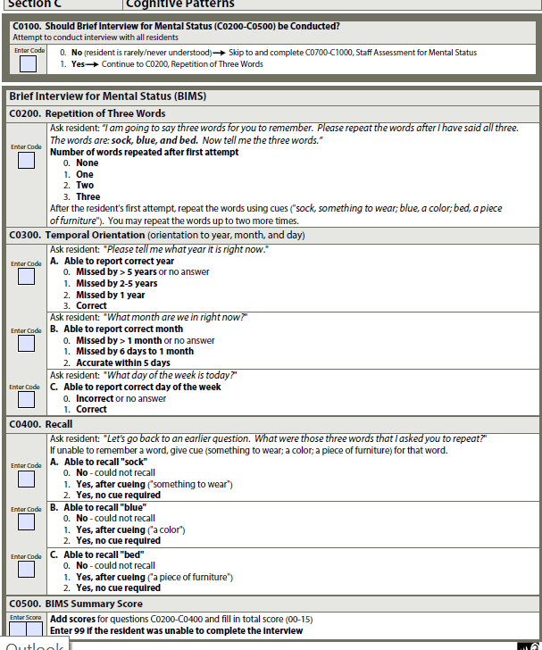
BIMS in the MDS

Slide 35
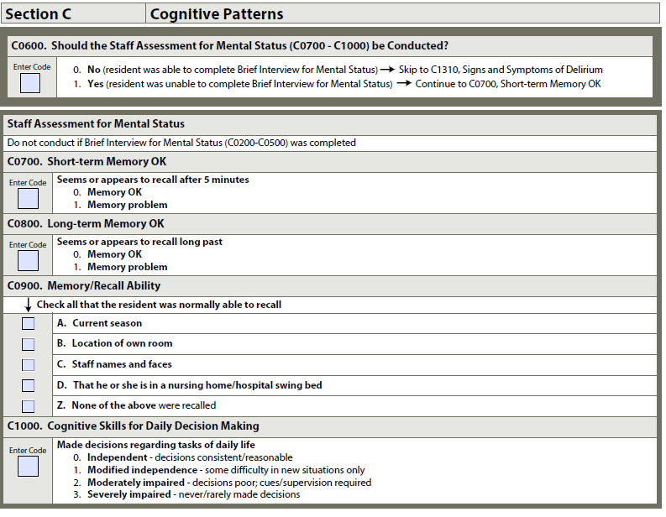
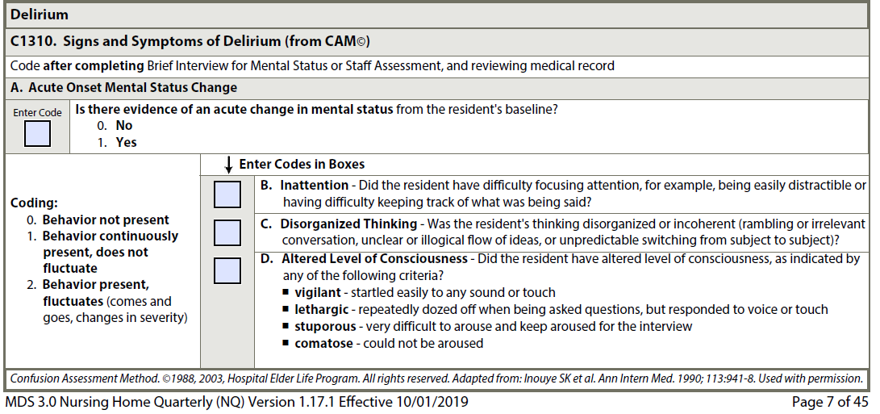
Mental Status and CAM in the MDS

Slide 36
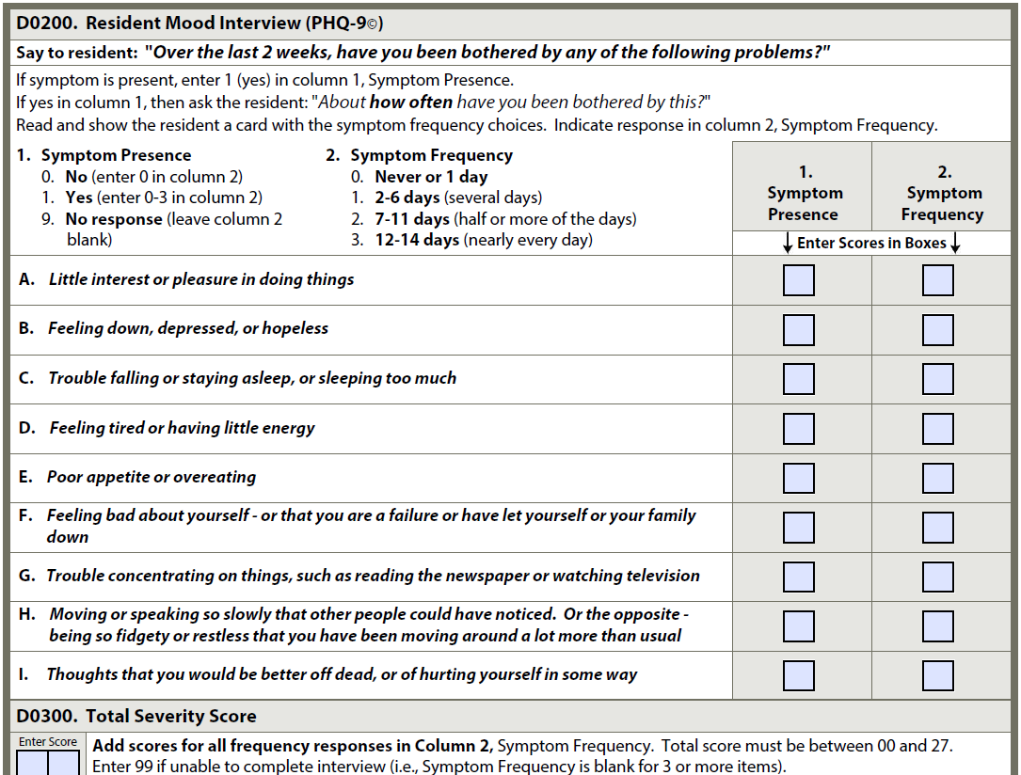
PHQ-9 in the MDS

Slide 37
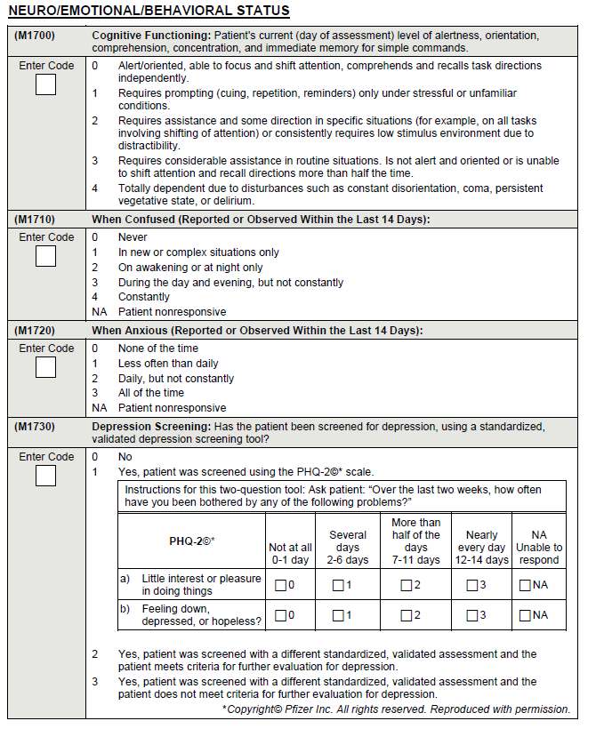
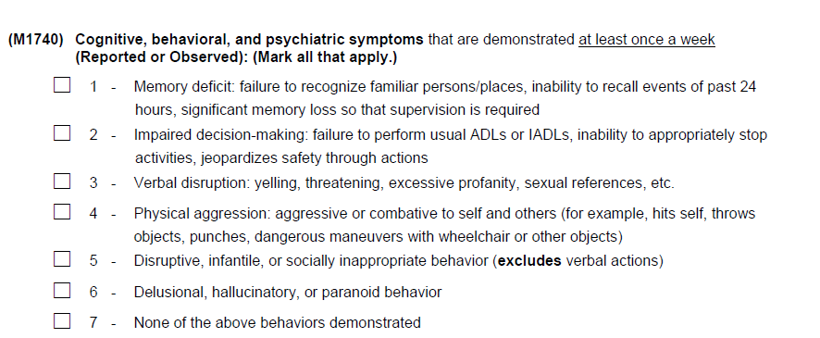
Cognition in OASIS D

